Slide 1

Hardware Implementation of Elliptic Curve Cryptography
Debapriya Basu Roy
Department of Computer Science & Engineering
Indian Institute of Technology Kanpur
dbroy@cse.iitk.ac.in
dbroy24@gmail.com

Slide 2


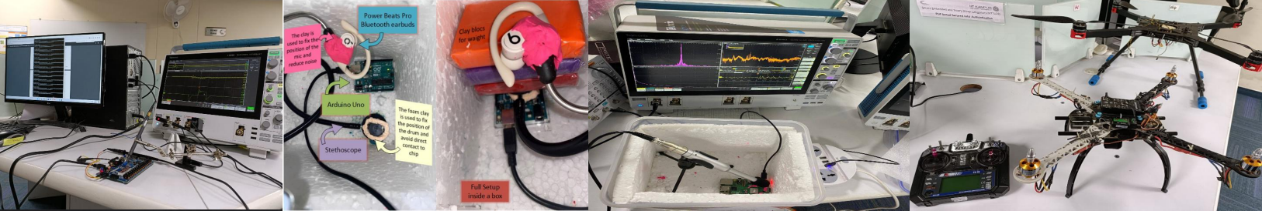





Secure Embedded and Smart Things Laboratory (SETTLOR)
First Floor, C3i Center Building, IIT Kanpur-208016
Laboratory Website: https://cse.iitk.ac.in/users/urbic/research/
Publications:
Conferences: DATE, DAC, IEEE HOST, ESWEEK, VLSID, SPACE, AsianHOST, GLSVLSI.
Journals: IEEE ESL, ACM TECS, Springer JCEN, IEEE TCAS-1.
Research Areas:
Approximate Computing, Acoustic Side Channel Attacks, Physically Unclonable Functions, Timing Attacks on Network-on-Chip, Post-Quntum Cryptography

Slide 3
Hardware Implementation: Why it is Important?
Faster Development Time
Flexible, easy to update
Software Implementations
Significantly Slow
Difficult for constant time
memory and micro-architectural attacks
Side Channel Attacks
Fastest Execution, constant time
No software specific attacks
Targeted for specific crypto-algo.
Hardware Implementations
Longer Development time
Higher Overhead, not flexible
Side Channel Attacks
Cryptographic Algoithms: Complex and computationally intensive mathematical functions
Software Implementations: Slow, may create speed bottleneck during the executions of crypto-algorithms
Software specific attacks: Buffer overflow attack, Spectre, Meltdown!!
Hardware: Dedicated architecture for cryptographic algorithms, fast, efficient, but not flexible.
Hardware-Software Codesign: Accelerating crypto-algorithms by offloading a portion of the computation to hardware.
Combines flexibility of software+effciency of hardware, generally done by instruction set extension.
Example: AES-NI, PCLMULQDQ Instructions on Intel for accelerating AES and Elliptic Curve Operations.

Slide 4
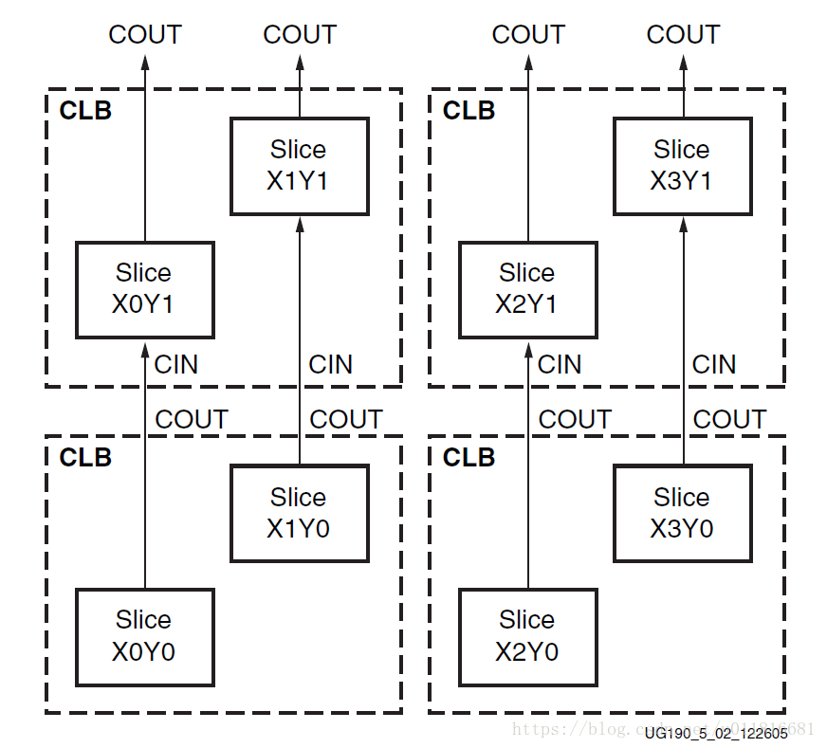
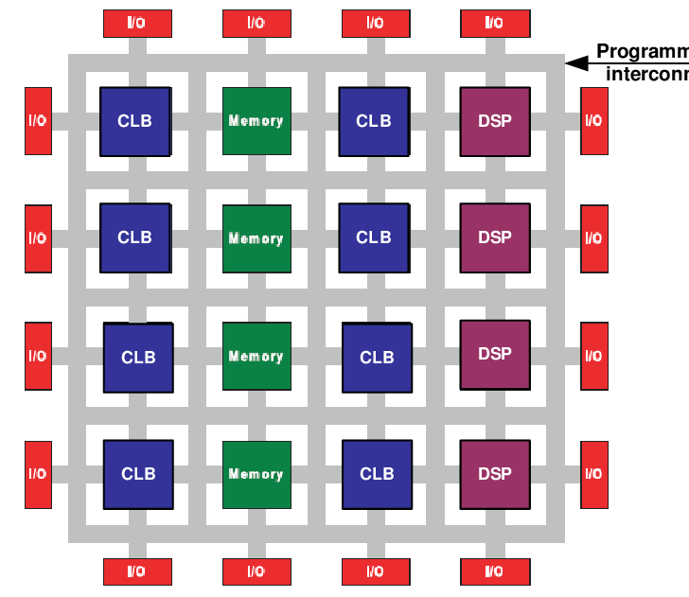
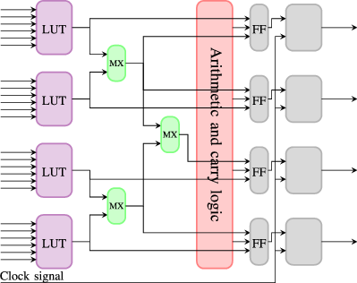
Field Programmable Gate Array (FPGA)
ASIC Design: Fast and dedicated architecture for the target application
Expensive and time consuming (typically one need to wait around 5-6 months to get the final chip after layout is finalized)
Any error in the design will require reiteration of this long procedure
FPGA: Islands of Programmable logic block in the sea of programmable reconnect

Slide 5
FPGA Advantages
Modern FPGAs: Equipped with hardware-IPs (hard-IPs: DSP blocks and ) to reduce the performance gap between FPGA and ASIC Designs
Faster development time than ASIC, in house security for crypto algorithms
Modern processor cores like ARM now being integrated with FPGA to take advantage of the speed gain of FPGA architectures (Xilinx Zedboard)
FPGA inside CPU: Possibility as Intel has recently bought FPGA company Altera
Developing FPGA architecture is not just writing HDL codes
A
B
C
A
B
C
RCA
CSA
RCA
RCA
Result
Result

Slide 6
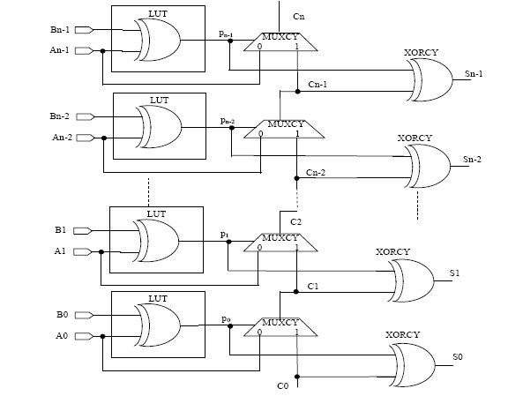
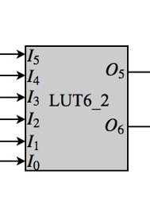
FPGA Hard-IP: Carry Chain and LUTs
Carry4 : Dedicated fast routing for carry propagation --> Reason behind RCA faster than CSA
LUT6_2: Implement any 6 input, 1 output function or any 5 unput 2 output function

Slide 7
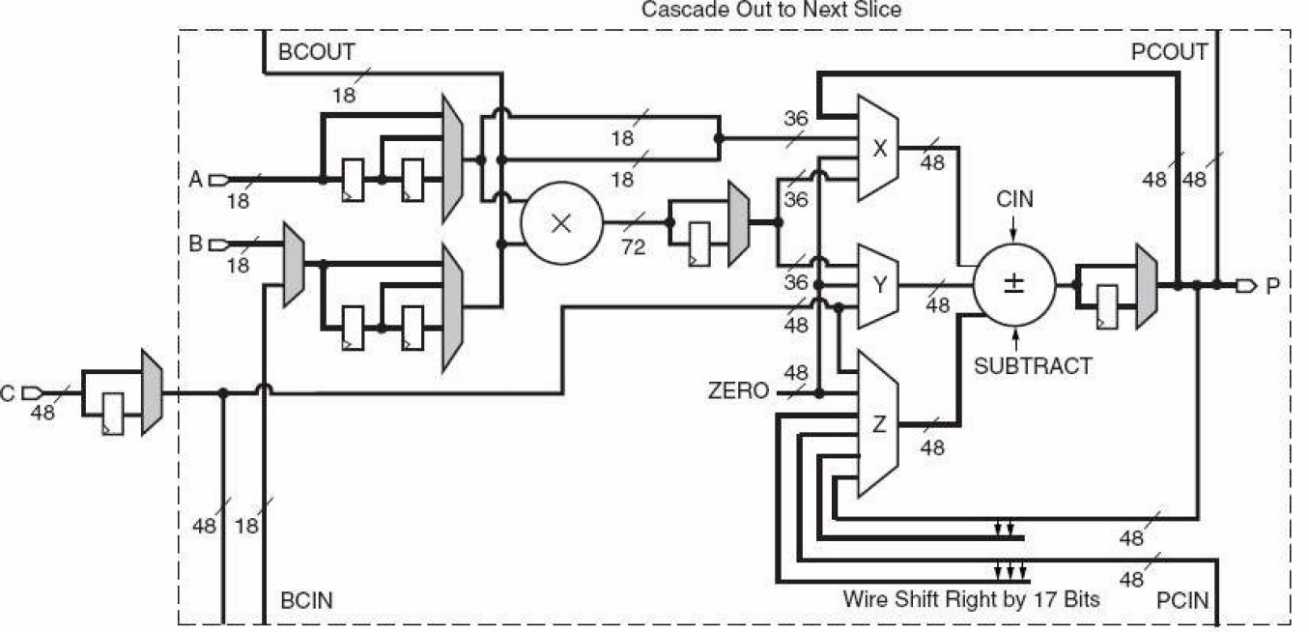
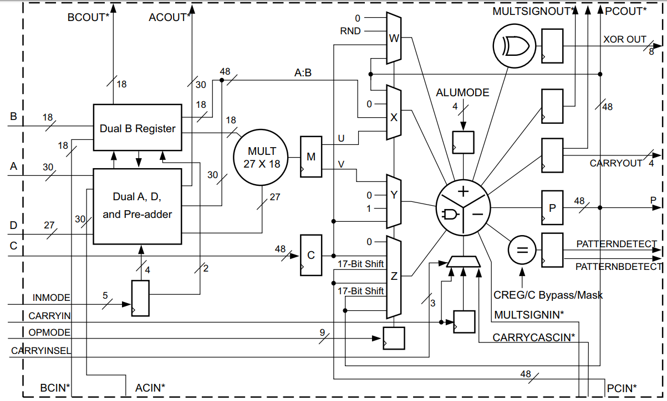
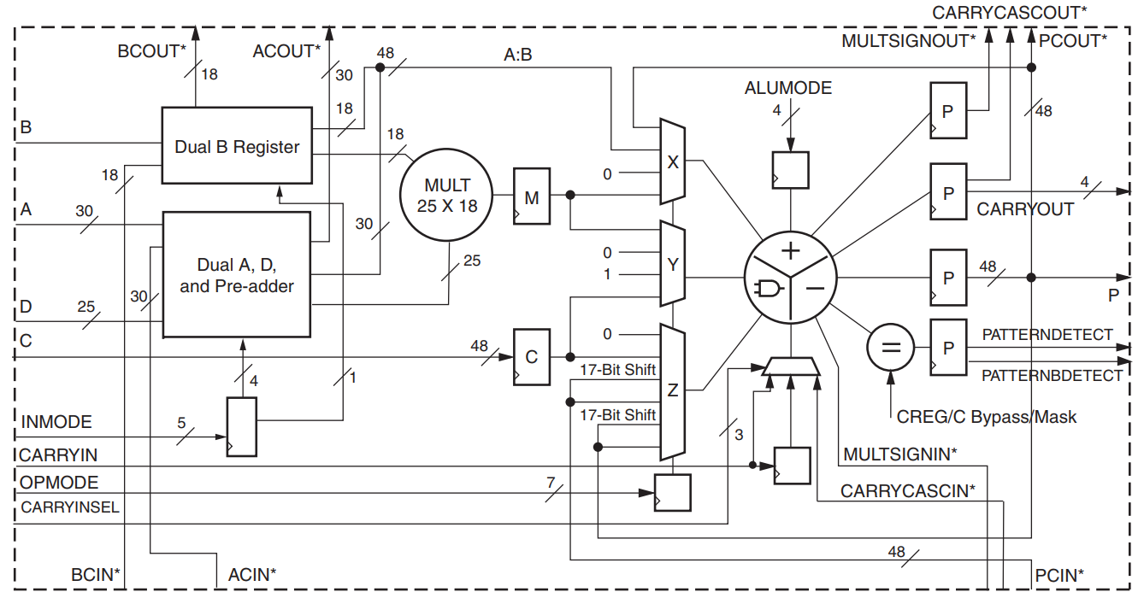
DSP Blocks: Evolution
Virtex-4:18 x18 signed mult.
Virtex-5,6,7: 25 x18 signed mult.
Virtex 7 Ultrascale: 27 x18 signed mult.
Our objective will be to device optimal architecture of field multipliers using asymmetric integer multipliers of these DSP blocks

Slide 8
Next: Public Key Cryptography
Assignment 1
Desgin a Finite Filed Adder in FPGA
Desgin a Finite Filed Multiplier in Verilog
Shortcoming of Symmetric Key Cryptography
Introduction to Public Key Cryptography
Elliptic Curve Cryptography

Slide 9
Symmetric Key Cryptography
Till now in the lecture we have learnt about block cipher and stream ciphers
They are part of broad category of cryptographic algorithms known as symmetric key cryptography
Block ciphers are generally built using SPN (substitution permutation network) architecture (like PRESENT) or Fiestel architecture (like block cipher CLEFIA)
Stream ciphers are based on mostly LFSRs and NFSRs
Now the challenge is how we can make sure that the two communicating party have a common key??
Can not be used if there is no common key
Can not be used for cryptographic signature algorithm
Confidentiality
Integrity
Authentication
Fast
Symmetric Key Cryptography

Slide 10
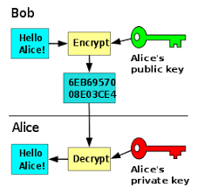
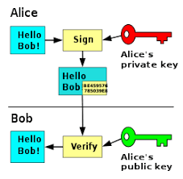
Asymmetric Key Cryptography/ Public Key Cryptography
Asymmetric key cryptography is used to share the key between two party
In this case, each communicating party has a pair of key (private key, public key)
private key is secret, and public key is known to everyone
Encryption
Digital Signature
Picture Source: Wikipedia

Slide 11
Asymmetric Key Cryptography/ Public Key Cryptography
Public key cryptographic algorithms are generally based on some computationally hard mathematical problem known an trapdoor oneway function.
Public key : transform values from G1 to G2
Without t (private key) we can not do the
inverse operation.
Example of oneway function with trapdoor:
Exponentiation of a number mod N
N =p x q , p and Q are prime
Elliptic Curve Scalar Multiplication
G1
f: G1-->G2
G2
Easy
Hard
Easy with additional information t

Slide 12
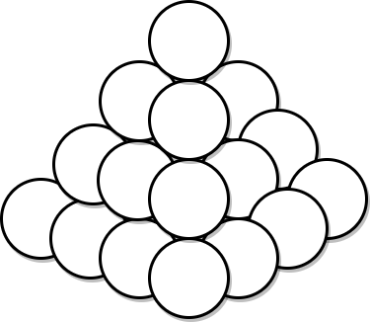
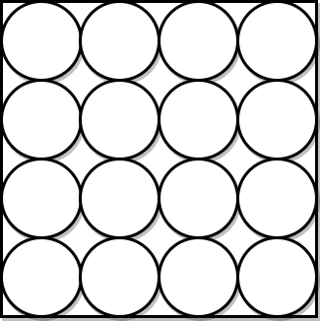
Cannonball Problem
We want to place cannonballs in a square pyramid. Square pyramid is a structure where the i^{th} layer contains i² cannonballs.
x
y
Square Pyramid
Square Array
Question: Find out the number of cannonballs for which the square pyramid and square array will have same number of cannonballs (apart from 0 and 1)

Slide 13
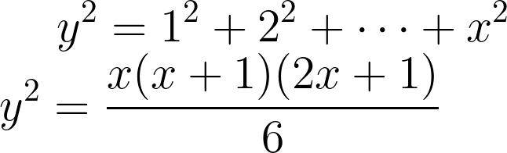
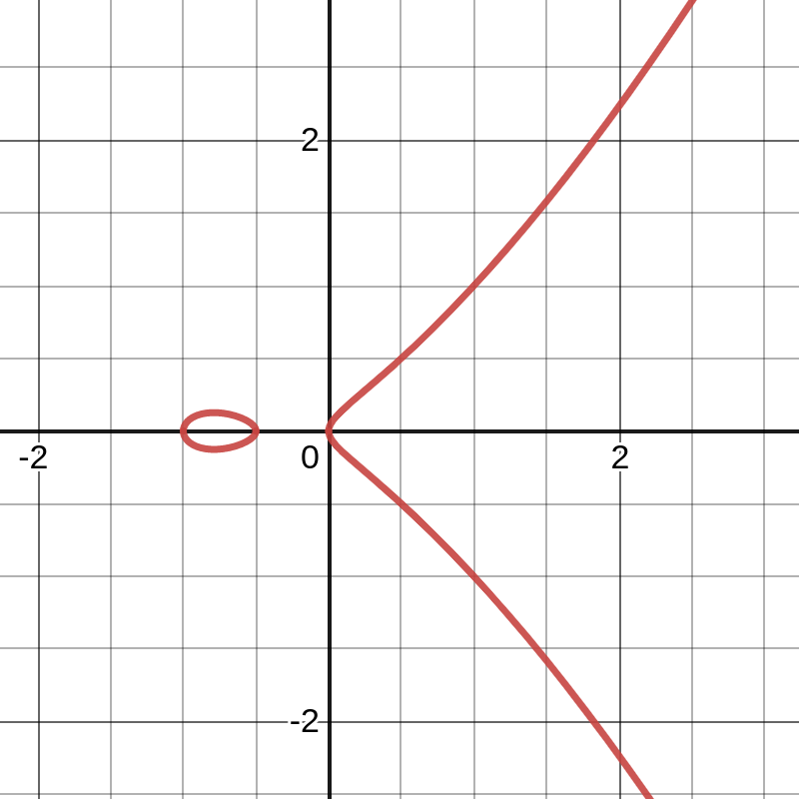
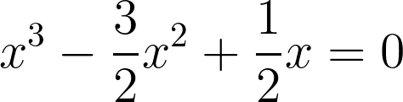
Solution
By plotting this equation what we get is an elliptic curve (nothing to do with an ellipse),
Feature: symmetric with two distict lobe
If (x,y) is on the curve, so is (x,-y)
(0,0) and (1,1) are two points on the curve
How to find other points on the curve?
(0,0) and (1,1) are on the curve, line y=x intersect the curve on point (0,0) and (1,1).
However, as the elliptic curve equation is cubic in term of x, it should intersect the curve on another point
Substituting y=x in the elliptic curve equation, we get
From theory of equations, x₁+x₂+x₃=3/2, where x₁, x₂, x₃ are the root of the equation
x₁=0 and x₂=1, then x₃=1/2
The corresponding y coordinate is 1/2 => (1/2,1/2) is another point on the curve

Slide 14
Elliptic Curve Cont´d:
(0,0), (1,1), (1/2,1/2) are the points on the curve
(1,-1), (1/2,-1/2) are two other points on the curve (by symmtry operation)
We can keep on continuing the same approach to find the other points
Construct the equation of the line with points (1,1) and (1/2,-1/2) : y=3x-2
Find out the corresponding x and y coordinate using the discussed approach
In the context of cannonball problem, x is the height of pyramid and y is the dimension of the square array
Elliptic Curve for Cryptography
The usage of Elliptic curve, defined over some finite field, for Diffie-Hellman key exchange was first proposed by Victor Miller and Neal Koblitz in 1985
It is based on the hardness of computing discrete logarithm problem in the Elliptic curve domain

Slide 15
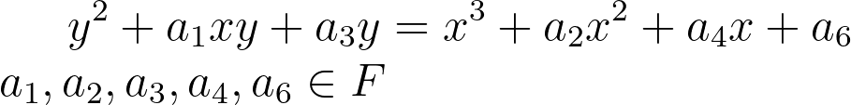
General form of Elliptic Curve
Weierstrass Equation: An elliptic curve defined over some finite field F can be presented as:
Depending upon the underlying finite field, we can simplify the above equation:
GF(p): General form --> (prime curve)
GF(2^{m}): General form --> (binary curve)
In this lecture, our concentration would be more on elliptic curve defined over prime fields.
Apart from these curves, there also exist some special curves:
Montgomery curves
Edware Curves
BN Curves
Koblitz Curve

Slide 16
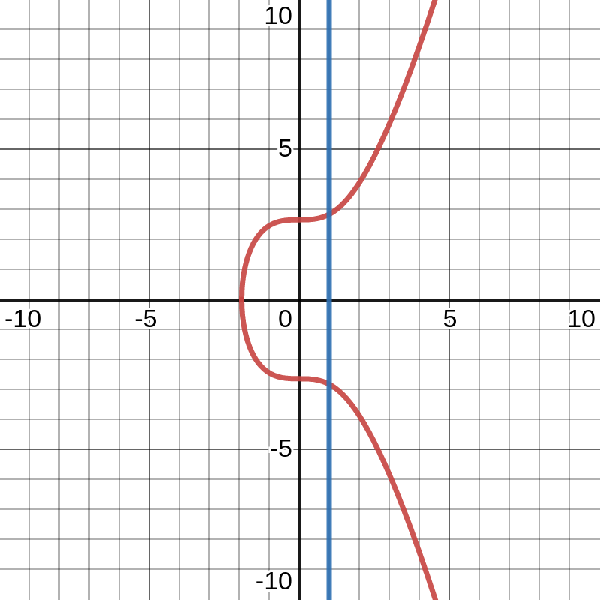
Points on Elliptic Curve E defined over field F
It is a set of points with coordinates (x,y) where each x and y value belongs to the field F
Point of Infinity
Consider the graph: y²=x³+7 and line x=1
The graph and and the line should intersect at
(1,2.828)
(1,-2.828)
another point (being a cubic equation)
This another point which does not seem to be on the graph but should be on the curve is the point of infinity (denoted as O)
for any point P on the curve: P+O=P (acting as an identity element)
for any point P on the curve: P+(-P)=O (acting as an identity element)
Negative of a point P (x,y) is -P(x,-y)

Slide 17
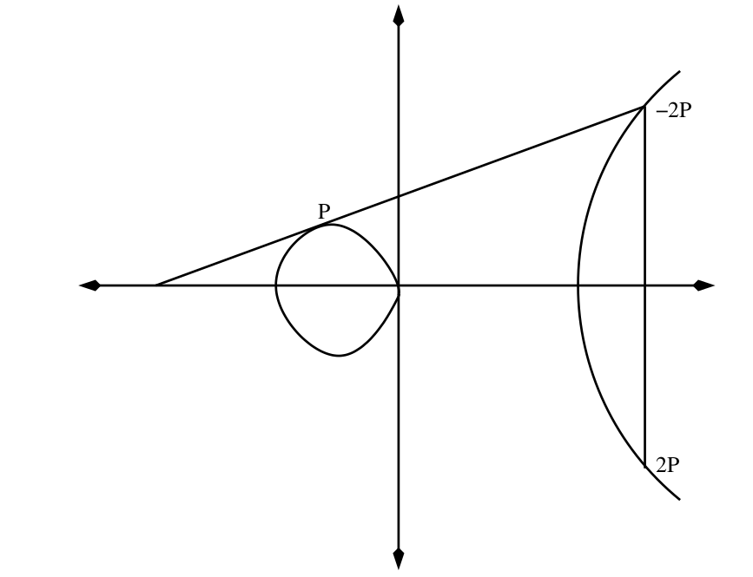
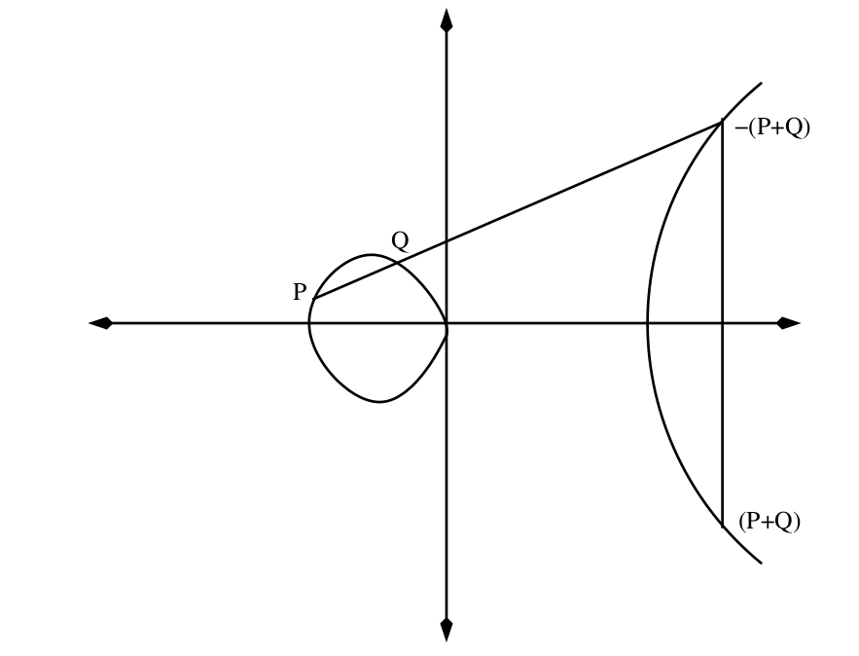
Operation over Elliptic Curve: Point Addition
Consider the Elliptic curve E defined over some field F. We want to add two point P and Q . This is known as point addition
For a given point P, we can compute 2P. This is called point doubling
Point Doubling
Point Addition

Slide 18
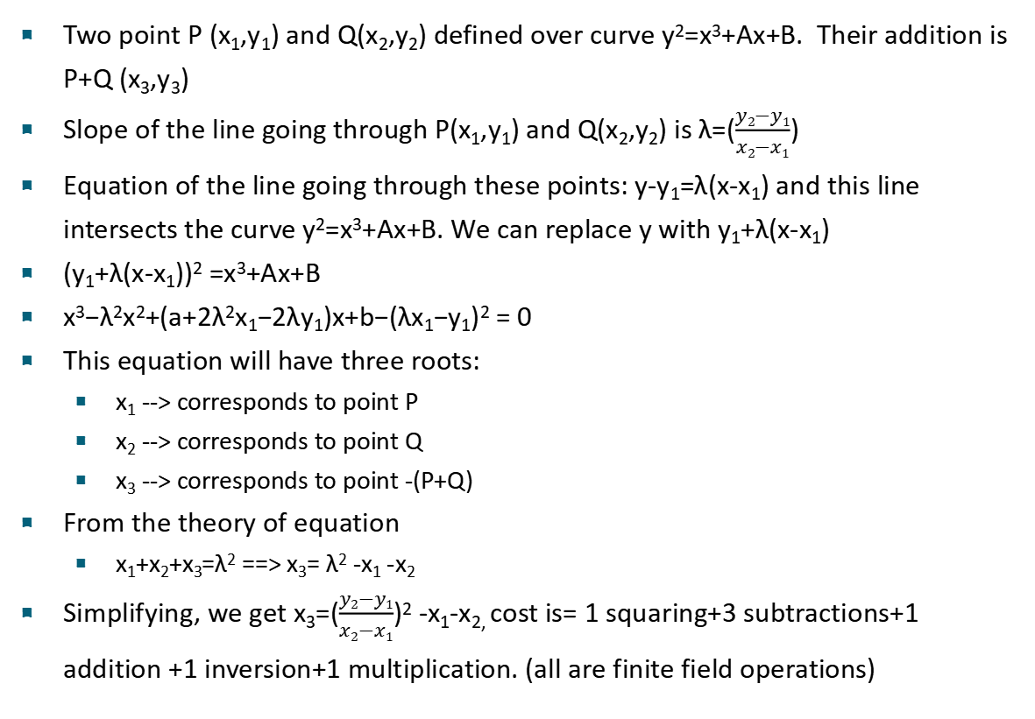
Point Addition Computation
Two point P (x₁,y₁) and Q(x₂,y₂) defined over curve y²=x³+Ax+B. Their addition is P+Q (x₃,y₃)
Slope of the line going through P(x₁,y₁) and Q(x₂,y₂) is λ=($\frac{y2−y1}{x2−x1}$)
Equation of the line going through these points: y-y₁=λ(x-x₁) and this line intersects the curve y²=x³+Ax+B. We can replace y with y₁+λ(x-x₁)
(y₁+λ(x-x₁))² =x³+Ax+B
x³−λ²x²+(a+2λ²x₁−2λy₁)x+b−(λx₁−y₁)² = 0
This equation will have three roots:
x₁ --> corresponds to point P
x₂ --> corresponds to point Q
x₃ --> corresponds to point -(P+Q)
From the theory of equation
x₁+x₂+x₃=λ² ==> x₃= λ² -x₁ -x₂
Simplifying, we get x₃=($\frac{y2−y1}{x2−x1}$)² -x₁-x_{2,} cost is= 1 squaring+3 subtractions+1 addition +1 inversion+1 multiplication. (all are finite field operations)

Slide 19
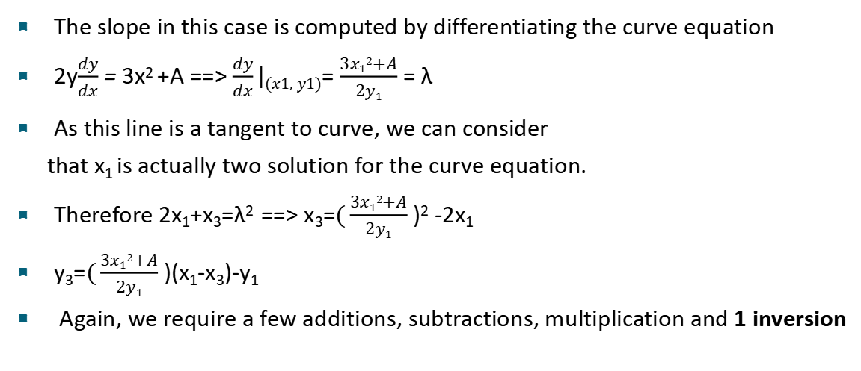
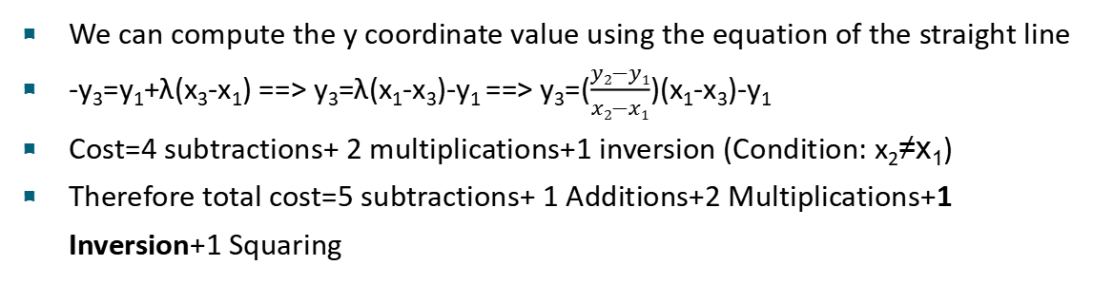
Point Addition Continued:
We can compute the y coordinate value using the equation of the straight line
-y₃=y₁+λ(x₃-x₁) ==> y₃=λ(x₁-x₃)-y₁ ==> y₃=($\frac{y2−y1}{x2−x1}$)(x₁-x₃)-y₁
Cost=4 subtractions+ 2 multiplications+1 inversion (Condition: x₂≠x₁)
Therefore total cost=5 subtractions+ 1 Additions+2 Multiplications+1 Inversion+1 Squaring
Point Doubling:
The slope in this case is computed by differentiating the curve equation
2y$\frac{dy}{dx}$ = 3x² +A ==> $\frac{dy}{dx}\left|(x1,y1)\right.$= $\frac{3x12+A}{2y1}$ = λ
As this line is a tangent to curve, we can consider
that x₁ is actually two solution for the curve equation.
Therefore 2x₁+x₃=λ² ==> x₃=$(\frac{3x12+A}{2y1}$ )² -2x₁
y₃=$(\frac{3x12+A}{2y1}$ )(x₁-x₃)-y₁
Again, we require a few additions, subtractions, multiplication and 1 inversion

Slide 20
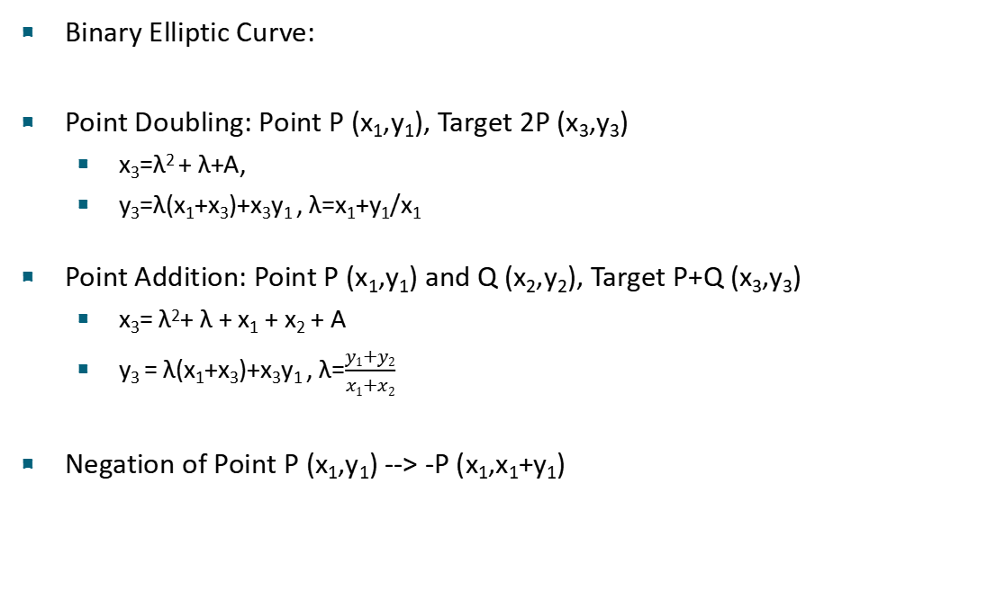
Point Addition and Doubling on Binary Curve
Binary Elliptic Curve:
Point Doubling: Point P (x₁,y₁), Target 2P (x₃,y₃)
x₃=λ² + λ+A,
y₃=λ(x₁+x₃)+x₃y₁ , λ=x₁+y₁/x₁
Point Addition: Point P (x₁,y₁) and Q (x₂,y₂), Target P+Q (x₃,y₃)
x₃= λ²+ λ + x₁ + x₂ + A
y₃ = λ(x₁+x₃)+x₃y₁ , λ=$\frac{y1+y2}{x1+x2}$
Negation of Point P (x₁,y₁) --> -P (x₁,x₁+y₁)

Slide 21
Addition between Point of Infinity O and P
To add with point of infinity, we draw a vertical line going through the point as we have assumed that point of infinity is somewhere vertical.
It will intersect the curve at point -P
Its projection will be point P itself
P+O=P
Elliptic Curve as Abelian Group
P+Q=Q+P (Commutative)
(P+Q)+R=P+(Q+R) (Associative)
P+O=(O+P)=P (Existance of additive Identity)
P+(-P)=O (Existance of additive inverse)

Slide 22
Elliptic Curve Scalar Multiplication
Consider Elliptic curve E defined over finite field GF(p). The order of the field is n
Consider a point P on this Elliptic curve E and a random integer k<n (known as scalar)
Scalar Multiplication: [k]P=P+P+P+... (add point P k times)
Elliptic curve discrete logarithm problem:
This problem is assumed to be computationally hard. The best possible algorithm which solves this problem is pollard-rho algorithm (on normal comuters).
Complexity: O((p)^{1/2}). For 256 bit prime, the attack complexity will be 2¹²⁸
For secure Elliptic curve, given points P and [k]P, find out the value of k

Slide 23
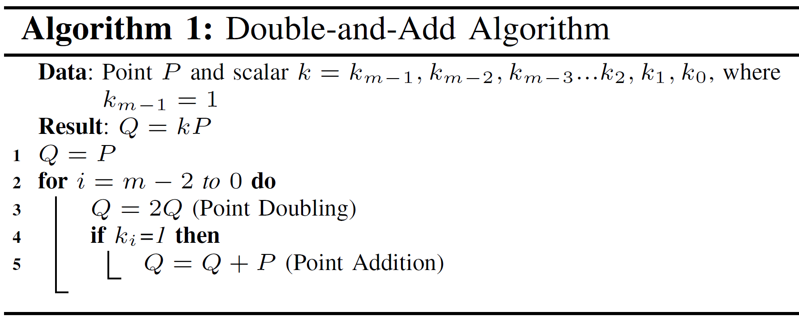
Scalar Multiplication Computation
Example: Compute 10P
k=10=(1010)₂ ,m=4, Q=P
iteration i=2, k_{i}=0, Q=2Q=2P
iteration i=1, k_{i}=1, Q=2Q+P=4P+P=5P
iteration i=0, k_{i}=0, Q=2Q=10P
This is the most simplistic and most efficient method for computing ECC scalar multiplication, but this algoithm has some serious vulnerability, and therefore is not used in practical implementations

Slide 24
Elliptic Curve Diffie-Hellman Key Exchange
Alice
Bob
1. Compute R_{A}=[s_{A}]P
2. Send R_{A}
1. Compute R_{B}=[s_{B}]P
2. Send R_{B}
Compute R_{AB}=[s_{A}]R_{B}
Compute R_{BA}=[s_{B}]R_{A}
R_{AB}=[s_{A}][s_{B}]P=[s_{B}][s_{A}]P=R_{BA}
Hard Problem: Computing s_{A} from the knowledge of R_{A} and P

Slide 25
Elliptic Curve Digital Signature Algorithm
Setup:
E defined over GF(p), y²=x³+Ax+B
Order of the curve n and the generator point G ([n]G=O)
Choose random integer 1<d<n
Compute H=[d]G, k_{pub}=(p,n,G,H), k_{priv}= d, message=m
Signature:
Choose random ephemeral key k_{r} , 1 < k_{r} < q.
Compute R = k_{r}G and r is the x coordinate of R
Compute s = (SHA(m) + d · r)(k_{r})⁻¹ mod n, (r,s) is the signature
Verification:
Compute value w = s⁻¹ mod n.
Compute value u₁ = w · SHA(m) mod n.
Compute value u₂ = w · r mod n.
Compute P = u₁G + u₂H.
If x coordinate of P = r mod n, the signature is valid. Otherwise, it is invalid.

Slide 26
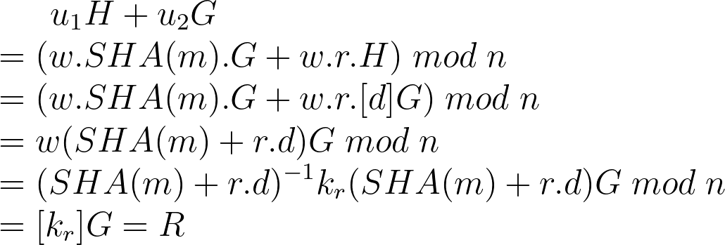
Elliptic Curve Example:
ECDSA: Proof
NIST Curves on GF(p) (Based on Solinas Prime)
NIST P-224: p = 2²²⁴ - 2⁹⁶ + 1
NIST P-256: p = 2²⁵⁶ - 2²²⁴ + 2¹⁹² + 2⁹⁶ - 1
NIST P-384: p = 2³⁸⁴ - 2¹²⁸ - 2⁹⁶ + 2³² - 1
Curve 25519: p=2²⁵⁵ -19 (Based on Pseudo-Mersenne Prime)
Ed448-Goldilocks: p = 2⁴⁴⁸ - 2²²⁴ - 1 (Based on Solinas Prime)
NIST Binary Curves defined over GF(2^{m}) (Based on trinomial and pentanomial)
The Elliptic curves that have been chosen for cryptographic applications are non-singular curves
Condition for non-singularity for elliptic curve defined over prime field is 4a³+27b²≠0

Slide 27
ECC and RSA Key Strength Comparison
Security | RSA Key Size | ECC Key Size
80 | 1024 | 160
112 | 2048 | 224
128 | 3072 | 256
192 | 7680 | 384
256 | 15360 | 521
ECC provides more security per key bit compared to RSA, hence ECC is more lightweight and compact than RSA
Unfortunately, in the presence of quantum computers, both traditional ECC and RSA will not remain secure and we would require new class of public key cryptography (post quantum secure public key algorithms)

Slide 28
Elliptic Curve Implementation Pyramid:
ECC Scalar Multiplication
Point Doubling, Addition
Operations in GF(p)
DSA
Critical operations are finite field computation in GF(p)
The field elements are of large dimension (from 192 to 521 bits), which makes implementing field operation even more challenging
ECC can be operated on Mersenne and Solinas reduction friendly prime, but the implementation become curve specific
For generic implementation of ECC, we require generic finite field architecture
The standard coordinate system (x,y) is known as affine coordinates
In affine coordinate, for each point doubling and addition, we require one field inversion

Slide 29
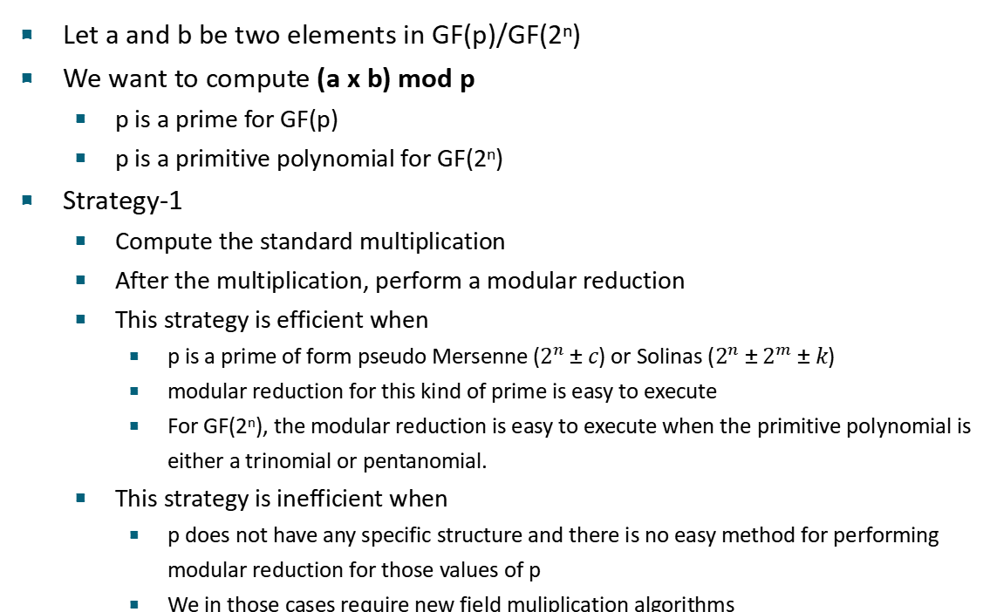
Field Multiplication Algorithms
Let a and b be two elements in GF(p)/GF(2^{n})
We want to compute (a x b) mod p
p is a prime for GF(p)
p is a primitive polynomial for GF(2^{n})
Strategy-1
Compute the standard multiplication
After the multiplication, perform a modular reduction
This strategy is efficient when
p is a prime of form pseudo Mersenne ($2^{n}±c$) or Solinas ($2^{n}±2^{m}±k$)
modular reduction for this kind of prime is easy to execute
For GF(2^{n}), the modular reduction is easy to execute when the primitive polynomial is either a trinomial or pentanomial.
This strategy is inefficient when
p does not have any specific structure and there is no easy method for performing modular reduction for those values of p
We in those cases require new field muliplication algorithms

Slide 30
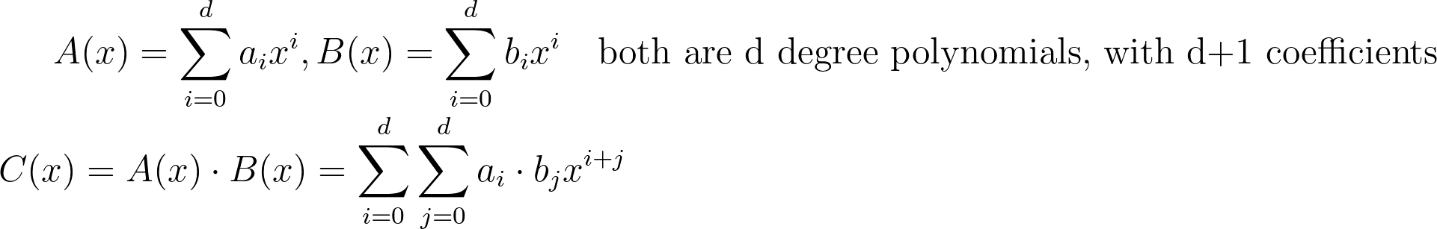
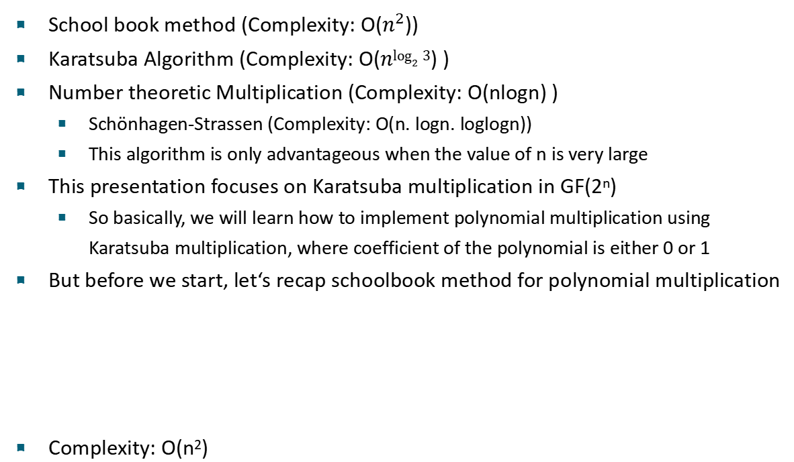
Standard Multiplication
School book method (Complexity: O($n^{2}$))
Karatsuba Algorithm (Complexity: O($n\log_{2}{3}$) )
Number theoretic Multiplication (Complexity: O(nlogn) )
Schönhagen-Strassen (Complexity: O(n. logn. loglogn))
This algorithm is only advantageous when the value of n is very large
This presentation focuses on Karatsuba multiplication in GF(2^{n})
So basically, we will learn how to implement polynomial multiplication using Karatsuba multiplication, where coefficient of the polynomial is either 0 or 1
But before we start, let‘s recap schoolbook method for polynomial multiplication
Complexity: O(n²)

Slide 31
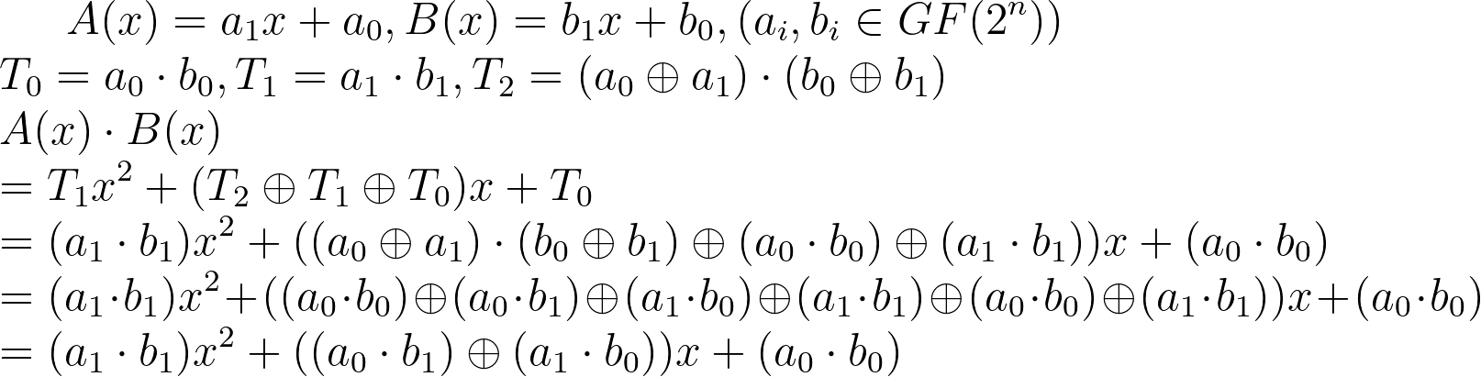
Karatsuba Multiplication in GF(2^{n})
Let us consider degree 1 polynomials
Cost of Karatsuba: 3 Multiplications, 4 Additions
Cost of Schoolbook Method: 4 multiplications and 1 addition
Tradeoff: In Karatsuba, We reduce one multiplication, but increase number of additions by 3
Karatsuba Method
School Book Method

Slide 32
When to apply Karatsuba
Cost of 1 multiplication is greater than 3 additions
Let us reconsider the degree 1 polynomial
The multiplication for degree 1 polynomial is basically AND operation
The addition for degee 1 polynomial is simple bitwise XOR operation
Therefore, for Karatsuba algorithm to be efficient, cost of implementing a single AND gate opertion should be more thant cost of implementing three XOR gate, which is not the case.
Therefore, for degree 1 polynomial, schoolbook algorithm is more efficient than Karatsuba algorithm.
MUL_{cost} > 3 x Addition_{cost}
Threshold for Karatsuba: Consider multipliations of polynomials of degree n.
If n > Threshold , MUL_{cost} > 3 x Addition_{cost} => Karatsuba algorithm is more efficient
If n <= Threshold , MUL_{cost} < 3 x Addition_{cost} => Schoolbook method is more efficient

Slide 33
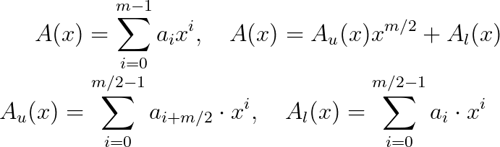
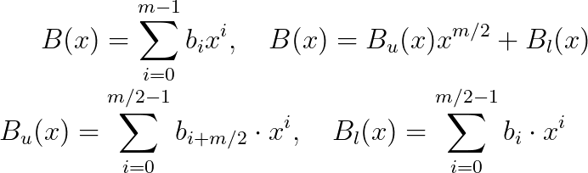
Application of Karatsuba
Consider two polynomials of degree 2^{n}-1, the number of coefficients in each polynomial is m=2^{n}.
A_{u} and B_{u} contains the coefficients from index m/2 to m-1
A_{l} and B_{l} contains the coefficients from index 0 to m/2-1
If we substitute x^{m/2} with y, we get
So, now we can easily apply Karatsuba method here

Slide 34
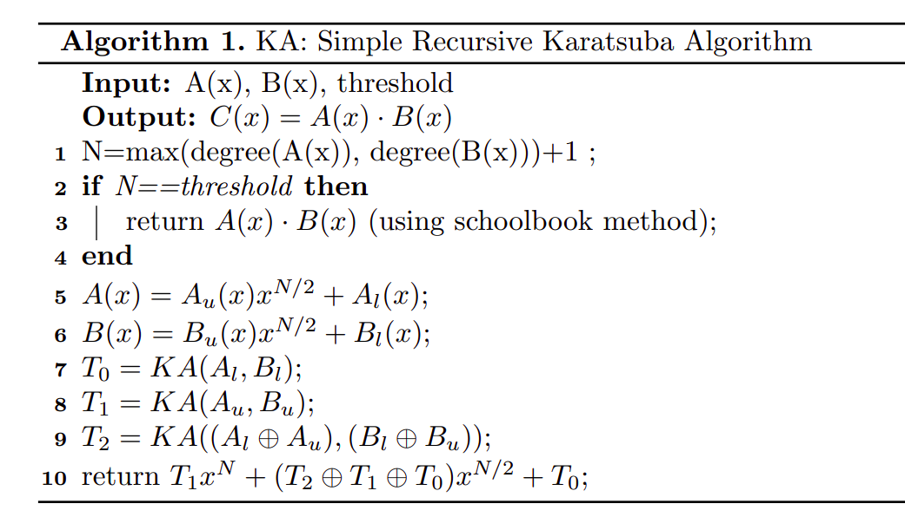
Simple Recursive Karatsuba Algorithm

Slide 35
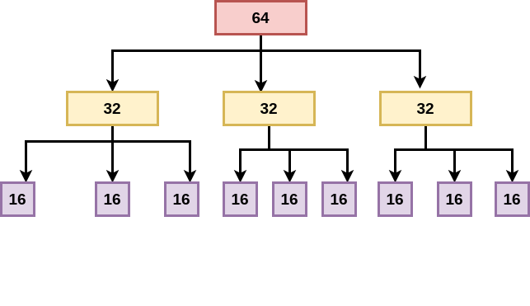
Example:
Let us consider two polynomials of degree 63 and number of coefficients 64
Threshold value varied from platform to platform. For FPGA platform, typically 16 is chosen as threshold.

Slide 36
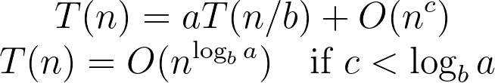
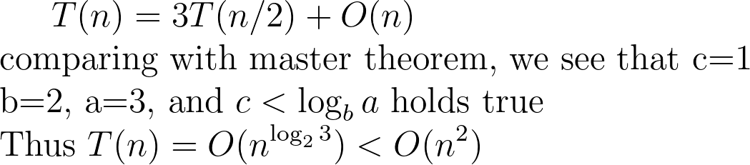
Complexity Analysis
Master Theorem of Recurrence:
Complexity of Karatsuba Algorithm

Slide 37
Applying Recursive KA for Arbitrary polynomial
Remember the first computation step of Karatsuba algorithm:
N=max(degree(A(x)), degree(B(x)))+1
In this case, the value of N will not be even always
Trick: Splid the operand polynomial into a lower part of ⌈N/2⌉ coefficients and upper part of ⌊N/2⌋ coefficients

Slide 38
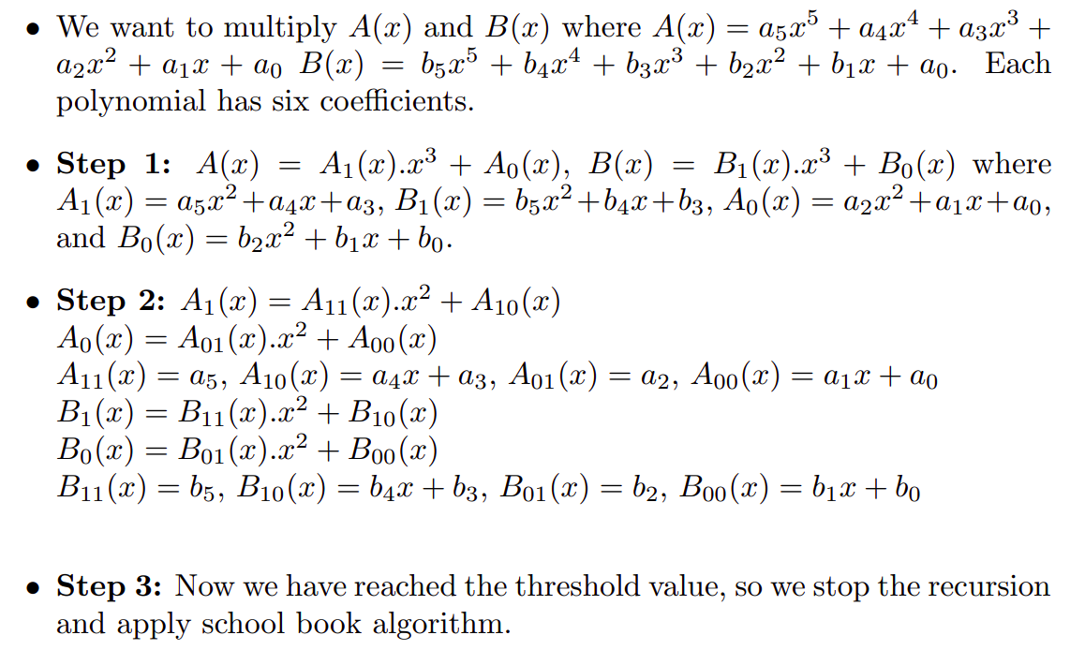
Example
In this particular example, we consider threshold as 1.
b₀

Slide 39
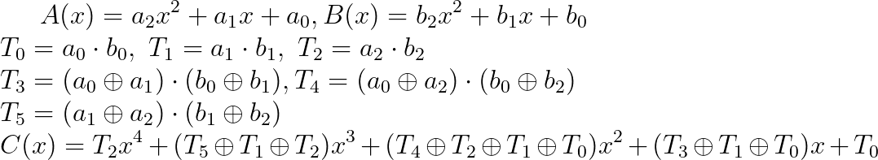
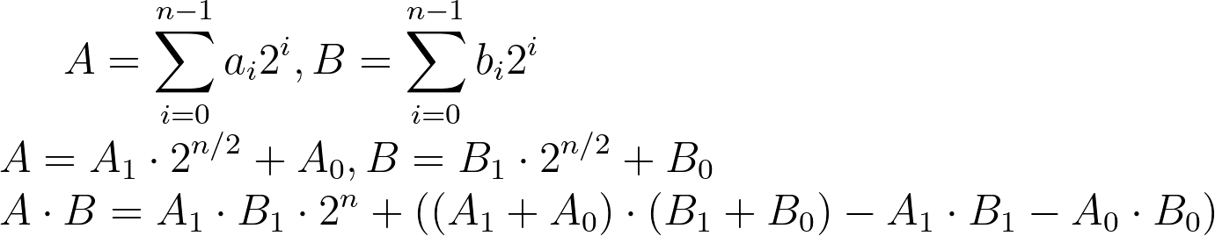
An alternative approach to Recursive Karatsuba
Let us again consider two polynomial A(x) and B(x)
This kind of methodology can be applied to any generic arbitrary polnomial. But, for most of the cases, recursive KA is as efficient as this method.
Integer Multiplication using Karatsuba:

Slide 40
Fast Modular Reduction
As we have already stated, modular multiplication with some specific prime or primitive polynomial is easy to execute
Here, we will focus on two such example
Modular reduction using trinomial primitive polynomial
Modulat reduction using Solinas prime

Slide 41
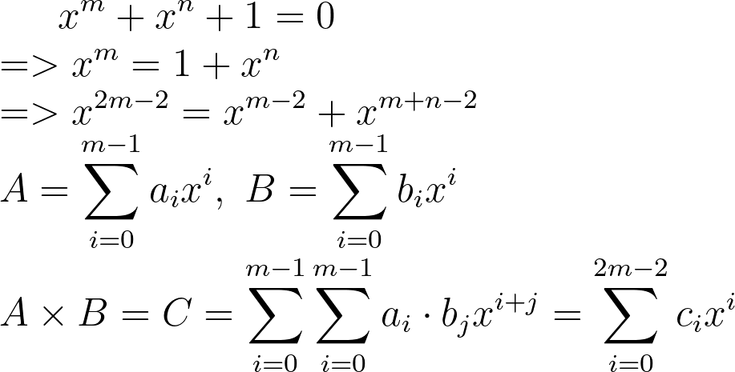
Polynomial Reduction using Trinomial
Let us consider a trinomial:

Slide 42
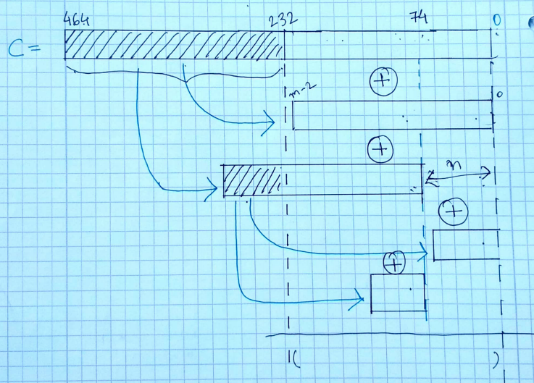
Example:
Trinomial: x²³³ + x⁷⁴ + 1, therefore in our example, m=233 and n=74.
Similar Strategy can also be applied to pentanomial

Slide 43
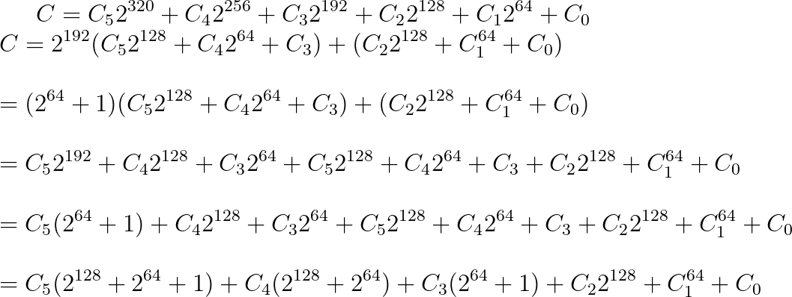
Modular Reduction using Solinas Prime
Let us consider a prime P= 2¹⁹²-2⁶⁴-1 => 2¹⁹²=(2⁶⁴+1) mod P
A x B=C, A and B are 192 bit intger and belongs to GF(P), the product C is 384 bit wide. Each C_{i}
This term should be C₁2⁶⁴
This term should be C₁2⁶⁴

Slide 44
Final Solution
T = C₅ || C₅ || C₅ => C₅2¹²⁸+C₅2⁶⁴+C₅
S₁= C₄ || C₄ || 0 => C₄2¹²⁸+C₄2⁶⁴
S₂= 0 || C₃ || C₃ => C₃2⁶⁴+C₃
S₃ = C₂ || C₁ || C₀ => C₂2¹²⁸+C₁2⁶⁴+C₀
The final result is obtained by adding T, S₁, S₂ and S₃ . Thus the entire modular reduction can be implemented by usig additions only. To reduce the addition result into GF(P), a few subtractions would be necessary.
I request you to think about how to perform modular reduction for prime P=2²⁵⁵-19 using only addition and subtraction

Slide 45
Finite Field Inversion: Fermat´s little theorem
Let us consider a finite field GF(p) and a is a random element in this field. Also, p does not divide a. Proof the following relation:
a^{(p-1)} = 1 mod p
Proof: Let us consider the following elements: a, 2a, 3a, …, (p-1).a. Now suppose there exist two elements r and s < p, such that
ra=sa mod p.
Then we can conclude that r =s mod p (as a≠0). Moreover, as both
r and s are less than p, then r=s. Therefore we can conclude a,2a,3a,…,(p-1).a are all unique elements: total (p-1) unique elements.
Hence, we can write the following expression:
a x 2a x 3a … x(p-1).a = 1x2x3x… (p-1) mod(p) (in some order)
=> a^{p-1}x (p-1)!=(p-1)! mod p => a
This theorem is known as Fermat‘s little theorem
From here we can see that inverse of an element a is a^{p-2} mod p

Slide 46
Algorithm to Compute Exponentiation
Input: a, p-2 in its binary from= {p_{n-1},…,p₂, p₁, p₀}. p is a n bit prime
Output: a^{p-2}
Naive Method
Ladder Method
1. r=1;
2. For (i=n-1 to 0)
3. r= r x r
4. If(p_{i}==1)
5. r=r x a
6. end For
7. Return r
1.r₀=1,r₁=a;
2. For (i=n-1 to 0)
3. If(p_{i}==0)
4. r₁=r₁x r₀
5. r₀=r₀x r₀
6. else
7. r₀=r₁x r₀
8. r₁=r₁x r₁
9. end For
10. Return r₀
Non constant time, number of multiplication is equal to HW(p-2)
Constant time, number of multiplications is n and number of squarings is n

Slide 47
Extended Euclidean Inversion Algorithm
Input: a, p
Output: gcd(a,p), d=a⁻¹ mod p
This algorithm is more efficient than the Fermat´s little theorem
Does not require multiplication and squaring, can be implemented using shifter, additions and subtractions
Difficult to make constant time
1. u=a,v=p, A=1,B=0, C=0, D=1
2. while(u!=0)
3. while even(u)
4. u=u/2
5. if even(A) and even(B) then
6. A=A/2, B=B/2
7. else
8. A=(A+p)/2, B=(B-a)/2
9. while even(v)
10. v=v/2
11. if even(C) and even(D) then
12. C=C/2, D=D/2
13. else
14. C=(C+p)/2, D=(D-a)/2
15. if u >=v then
16. u=u-v, A=A-C, B=B-D
17. else
18. v=v-u, C=C-A, D=D-B
19. Return v,d=C mod p
Implementation of inversion using either of these two algorithms much more expensive then field multiplications.
For each doubling and addition in affine coordinates require one inversion, for n bit scalar, in worst case we require 2n inversions
Can we reduce the number of inversions while doing scalar multiplication

Slide 48
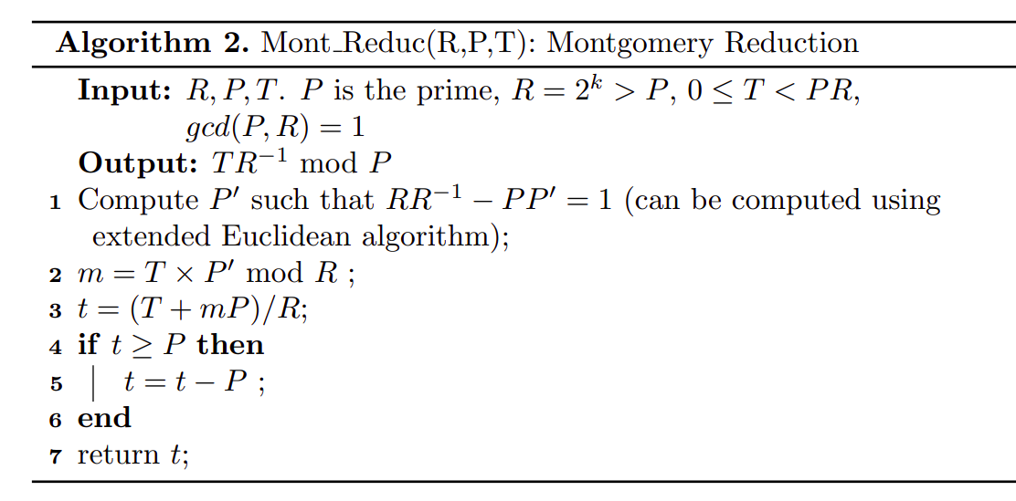
Montgomery Multiplication
Objective: To compute a * b mod P for any generic arbitrary prime
R is chosen as 2^{k} so that “mod R“ and division by R are easy to implement.
RR⁻¹-PP'=1 also means that PP'=-1 mod R

Slide 49
Proof of correctness
Claim 1: t=(T+mP)/R is an exact division i.e. (T+mP) mod R =0
Proof:
T+mP mod R
= (T+P(T.P' mod R)) mod R
=(T+T(P.P' mod R )) mod R
=(T-T) mod R (because P.P' mod R=-1)
=0
Therefore, (T+mP)/R is an exact division
Claim 2: t=TR⁻¹ mod P
Proof:
0 <=m < R => mP < PR => T+mP < 2PR
Therefore, t=(T+mP)/R < 2P, and after the conditonal subtraction t < P.
Thus t=(T+mP)/R is equivalent to t=(T+mP)/R mod P
Now, t=(T+mP)/R mod P= (TR⁻¹ +mPR⁻¹) mod P= TR⁻¹ mod P
Assignment 2
Write the python code of mongomary multiplication

Slide 50
Efficient Finite Field Architecture

Slide 51





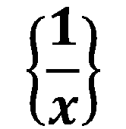
Objective: Finite Field Architecture
$$\left\{\frac{1}{x}\right\}$$
Modular Addition and Subtraction
Multi-operand Additions
Integer Multiplication for reduction friendly prime
Modular Multiplication for generic primes
Field Inversion
Challenges: To reach a optimal area-time tradeoff of these designs; Focus will be more on speed for this presentation
Develop implementations which exhibits better performance compared to state of the art architectures of ECC and SIKE algorithms.

Slide 52
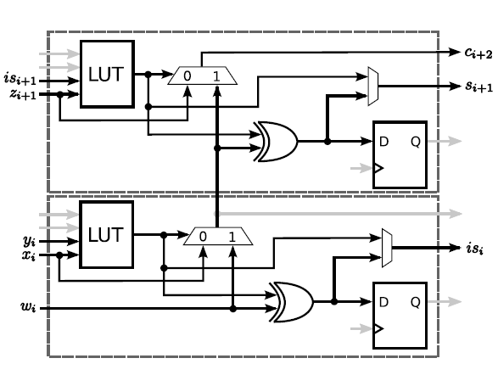
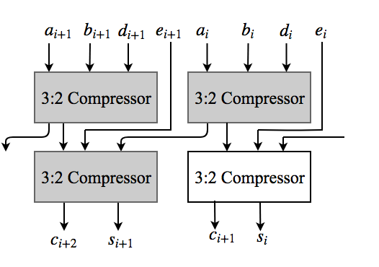
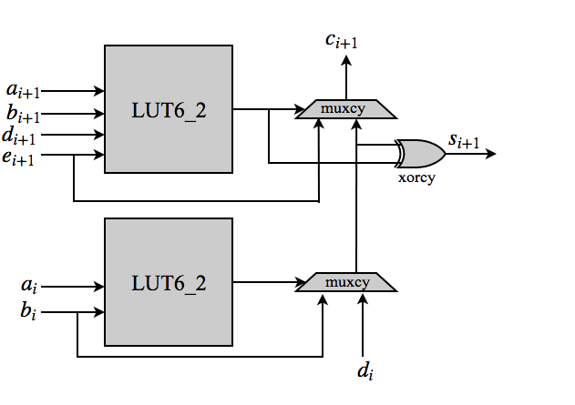
Multi-Operand Addition: 3:2 and 4:2 Compressor
2LUT_{D}+muxcy_{D}
Max(LUT_{D}+xorcy_{D}+muxcy_{D},LUT_{D}+2muxcy_{D})
52

Slide 53
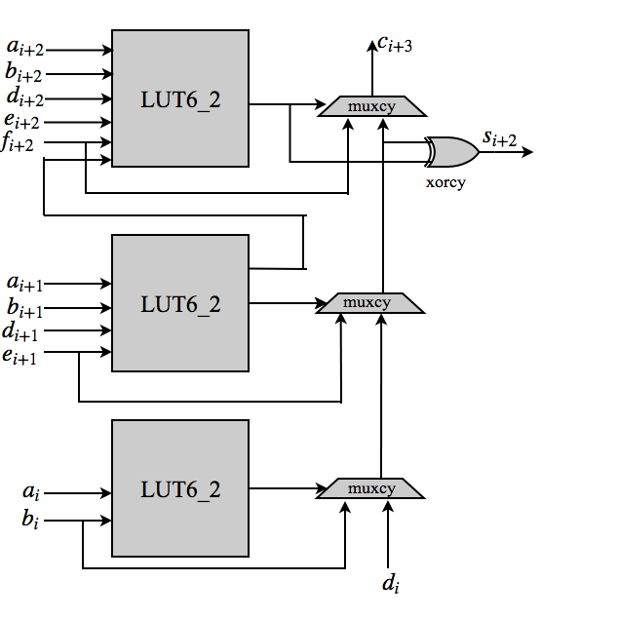
5:2 Compressor
Max(LUT_{D}+2muxcy_{D}+xorcy_{D},LUT_{D}+3muxcy_{D})
Multi-operand addition is useful for implementing modular reduction using pseudo-Mersenne or Solinas prime.
It will be very useful for implementing Montgomery modular multiplication.

Slide 54
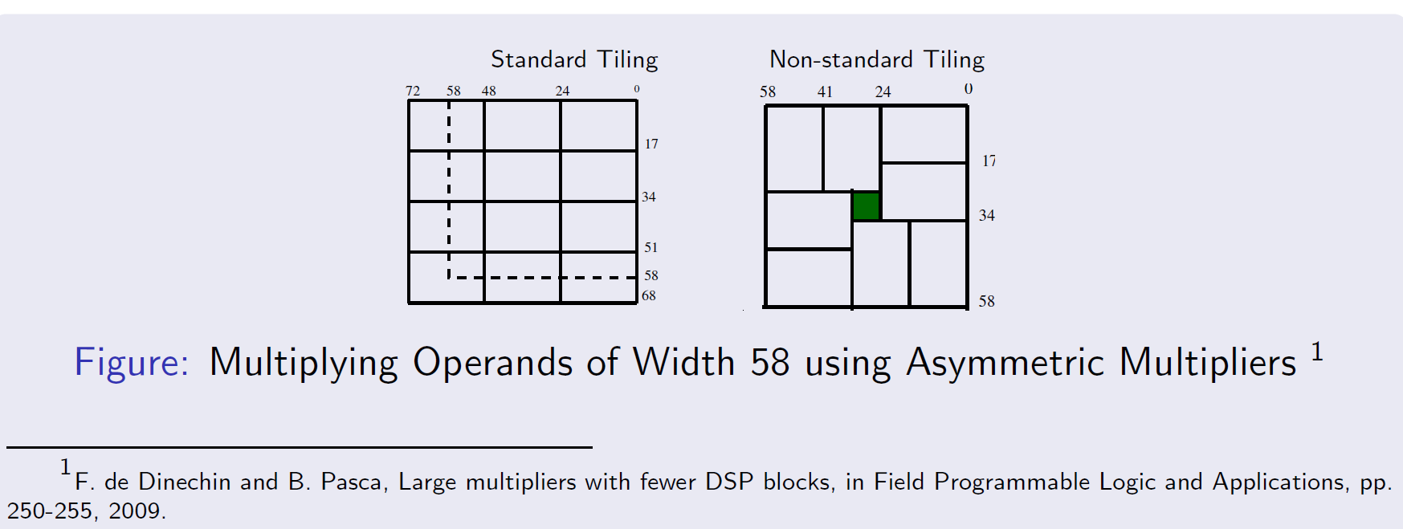
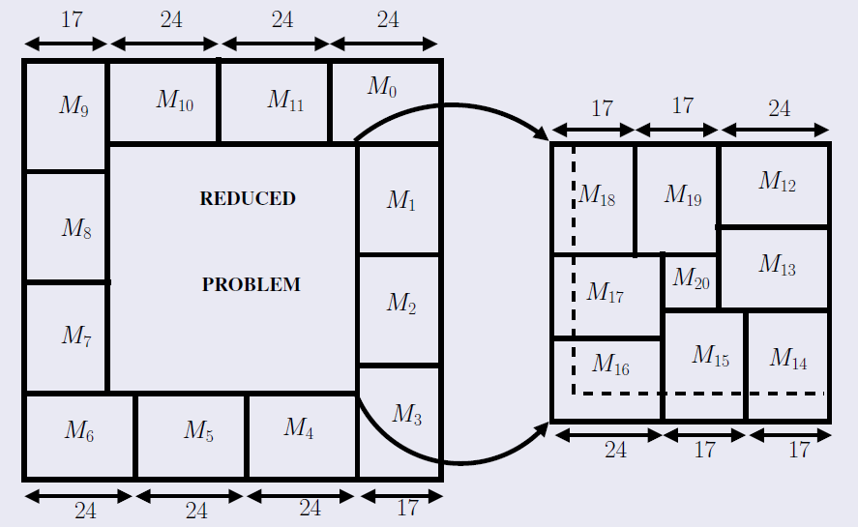



Integer Multiplication: Optimum Usage of DSP Blocks
DSP Block contains 24 x17 unsigned multiplier
58 x 58 Multiplication
School Book Method: 12 DSP
Non-standard Tiling: 8 DSP, 7x7 small mulltiplier
89=24x3+1x17
Standard Requirement =24
Non-Standard Tiling Requirement=20
54

Slide 55


P-256 and P-224
256=24x5+17x8; DSP Block Requirement=160, additional 16x16 multiplier is required
To multiply two operands of length 224, we map the problem to 222. We need to do three multiplications:
Both Operands having length 222
One having length 2 and another one having length 222.
One having length 223 and another one having length 2.

Slide 56

Results
Non-standard tiling requires fewer multiplier i.e. fewer DSP blocks
This multiplier can be useful for implementation with reduction friendly prime, or in any application which requires large integer multiplication.
This multiplier has been used by other researchers also for their own cryptographic implementation, one of them has used it for implementation of SIKE^{1,2}.
Tile Before Multiplication: An Efficient Strategy to Optimize DSP Multiplier for Accelerating Prime Field ECC for NIST Curves, Debapriya Basu Roy, Debdeep Mukhopadhyay, Masami Izumi, Junko Takahashi, DAC 2014: 177:1-177:6
1. Koppermann, Philipp, et al. "Fast FPGA implementations of Diffie-Hellman on the Kummer surface of a genus-2 curve." IACR Transactions on Cryptographic Hardware and Embedded Systems (2018): 1-17.
2. Massolino, P. M., et al. "A compact and scalable hardware/software co-design of SIKE."IACR Transactions on Cryptographic Hardware and Embedded Systems (2020).

Slide 57

Automatic Generation of Modular Multipliers Upon Pseudo-Mersenne Primes Using DSP Blocks on FPGAs¹
Features:
Automated modular multiplier generation upon Pseudo-Mersenne Primes
Supporting Modular addition and subtraction code generation in RNS bases
Conversion to and fro between integer and RNS bases
Outputs:
DSP :- Number of DSPs required excluding the square multiplier.
cycles :- Number of clock cycles required.
A :- Size of one of the operands that is supported by the multiplier.
B :- Size of the other operand that is supported by the multiplier. Inner :- Size of the square multiplier .
RecDes :- Flag that says whether the square multiplier has to be recursively designed.
From the requirements provided, the user can select a design that will be generated as a Verilog file.
1. Roy, Debapriya Basu. "Automatic Generation of Modular Multipliers Upon Pseudo-Mersenne Primes Using DSP Blocks on FPGAs." 2024 27th Euromicro Conference on Digital System Design (DSD). IEEE, 2024.

Slide 58


Non-Redundant Number System
A d digit non-redundant number X can be represented as (X_{d-1},…,X₁,X₀) where each X_{i} is a r bit number.
Addition of two non-redundant numbers A and B:
A₃ B₃ A₂ B₂ A₁ B₁ A₀ B₀
r
r
r
r
r
r
r
r
r
r
r
r
58
Carry Propagation

Slide 59
Redundant Number System
A d digit redundant number Y can be represented as (Y_{d-1}, …,Y₁,Y₀) where each Y_{i} is a r+n bit number. The group of r bits are principal bits and the group of n bits are redundant bits.
Addition of two redundant numbers
r
r
When r=1 and n=1, we obtain the basic carry save form.
No carry propagation between blocks
r
n
We have combined redundant number system with the asymmetric multipliers of DSP blocks to construct a novel Montgomery multiplier architecture that can be applied to both ECC and SIKE

Slide 60

Operations in Redundant Number System
X'=(X'_{d-1}, … X'₁,X'₀) be a d digit redundant number where the length of each X'_{i} is (r₂+2) bits. Similarly Y' is a single digit redundant number having length (r₁+2), where 2r₂<r₁+r₂+4<3r₂. We can compute the partial products P_{i}=X'_{i} .Y' using the asymmetric multiplier of dimension (r₁+2)x(r₂+2). The length of each P_{i} would be (r₁+r₂+4).
3
3:2
Compressor
This operation requires DSP blocks to generate the partial products and 3:2 compressor to combine them.
For our implementation we consider, r₁ as 15 and r₂ as 22 so that generation of each Pi fits into a single DSP block with 24x17 unsigned multiplier. The resulting Montgomery multiplier is called radix-22 redundant Montgomery multiplier

Slide 61


Operation in Redundant Number System
We now want to compute X'.Y'+C where C=(C_{d}, …, C₁,C₀)
3
5:2
Compressor

Slide 62

Proposed Architecture:
Input a is a redundant number with radix r₂ and b is a redundant number with radix r₁ (r₁=15, r₂=22)
Key Observation: When multiplayer layers are active, adder layers are inactive and vice versa
Table: 256 bit Montgomery multiplier on Xilinx Zedboard
#Mults. | Slices | LUTS | FFs (Flip Flops) | DSPs | Clock Cycles | Freq. (MHz) | Area overhead wrt. Single multiplier | Speed gain wrt. Single multiplier
1 | 889 | 2149 | 464 | 40 | 15 | 100.2 | NA | NA
2 | 1146 | 2164 | 1154 | 40 | 31 | 174.8 | 1.28 x | 1.68 x
4 | 1354 | 2779 | 3985 | 40 | 63 | 305.1 | 1.52 x | 2.89 x

Slide 63
Finite Field Architecture: Summary
Multi-operand Addition
Efficient usage of carry chain and six input LUTs
Non-standard Tiling
Optimum usage of DSP blocks
Based on redundant number system
Fast because of carry less arithmetic
Proposed non-standard tiling decomposition methodology
Can perform multiple modular multiplications simultaneously
Montgomery Multiplier
Proposed efficient circuit for 3:2, 4:2 and 5:2 compressors
Results in reduced usage of DSP blocks
Revisiting FPGA Implementation of Montgomery Multiplier in Redundant Number System for Efficient ECC Application in GF(p): Debapriya Basu Roy, Debdeep Mukhopadhyay, FPL2018: 323-326
Next Objective: Building ECC architecture using the developed finite field architecure

Slide 64
Projective Coordinates
Efficient ECC Architecure
Consider a point P (x,y) which is in affine coordinate
We can represent this point P into projective coordinates (X,Y,Z) where
x=X/Z^{c} , y=Y/Z^{d}
For a single point P in affine coordinate, we can have multiple projective coordinate representation: (X₁,Y₁,Z₁), (X₂,Y₂,Z₂) .... (X_{n},Y_{n},Z_{n}) as long as
x=X₁/Z₁^{c} =X₂/Z₂^{c}=...=X_{n}/Z_{n}^{c} , y=Y₁/Z₁^{d} =Y₂/Z₂^{d}=...=Y_{n}/Z_{n}^{d}
Some popular projective coordinate
Standard Projective Form (c=1, d=1)
Jacobian (c=2,d=3)
Lopez-Dahab (c=1, d=2) (used mainly in binary curve)
Let´s consider y²=x³+Ax+B with Jacobinan coordinate
(Y/Z³)²=(X/Z²)³ +AX/Z²+B ==> Y²= X³+AXZ⁴+BZ⁶

Slide 65


Point Addition in Jacobian Coordinate
We want to add two points P (X₁,Y₁,Z₁) (in projective coordinates) and Q (x₂,y₂)
Coordinate of P+Q in projective coordinate (X₃,Y₃,Z₃)
We want to double point P (X₁,Y₁,Z₁) to 2P (X₃,Y₃,Z₃)
Point Doubling in Jacobian Coordinate:

Slide 66
Overall cost
Point Doubling Cost: 8 Multiplications (considering squaring equivalent to multiplication and ignoring the cost of modular addition and subtraction as thier cost are negligible compared to cost of modular multiplications)
Point Addition Cost: 11 Multiplications
Neither of them require any field inversion
Converting affine point P (x,y) in to Jacobian coordinate P (X,Y,Z)
x=X, y=Y, Z=1
Converting Jacobian point P (X,Y,Z) in to affine coordinate P (x,y)
x=X/Z², y=Y/Z³, cost: 4 Mult.+1 Inversion
We can actually assign value to the point of infinity in projective coordinate: O=(0,1,0)

Slide 67
Differential Addition:
In differential addition, to perform addition of two points P and Q,we require the knowledge of P−Q.
Differential addition formula was first proposed for Montgomery curve.
One of the advantages of using differential addition in Montgomery curve is that the entire scalar multiplication can be performed using only the x coordinate of the points.
Scalar multiplication algorithm using differential addition on Montgomery curve is known as the Montgomery ladder.
A Montgomery curve E defined over GF(p) can be represented as below:
By²=x³+Ax²+x, A, B are field elements of GF(p)
To reduce the inversion, points in affine coordinate will be transformed in to standard projective format (c=1, d=1)

Slide 68


Differential addition with and Doubling with x coordinate
Consider the point P with coordinate (X₁,Y₁,Z₁) in standard projective domain
Then we define the x coordinate map as
x(P)=(X₁,Z₁) if P!=O
x(P)=(1,0) if P=O=(0,1,0)
xADD(x(P),x(Q),x(P-Q))=x(P+Q) ==> Differential Addition
xDBL(x(P))=x([2]P) ==> Doubling

Slide 69

Montgomery Ladder for Scalar Multiplication
Please note that at every iteration difference between R₀ and R₁ is always P
Example:Compute 10P
k=10=(1010)₂ ,m=4, R₀=P, R₁=2P
iteration i=2, k_{i}=0, R₀=2P, R₁=3P
iteration i=1, k_{i}=1, R₀=5P, R₁=4P
iteration i=0, k_{i}=0, R₀=10P, R₁=9P
R₀ has the final result
Weakness:
We need to check if k_{m-1}=1 or not.
If we know, which branch is taken, we can get the secret scalar

Slide 70

Montgomery Curve: Curve25519
The curve equation for Montgomery curve is E : y² = x³ + Ax² + x
For Curve-25519, A is 486662 and the modulus is 2²⁵⁵−19
Faster Differential Addition formula compared to generic short Weierstrass curve
X coordinate only formula: Does not require y coordinate values during ladder step
Constant time and simple power attack secure

Slide 71


Scheduling of Montgomery Ladder Steps
Scheduling with two multiplier has only one idle multiplicative step
Scheduling with four multipliers has 3 idle multiplicative steps
Step 6 of scheduling with two multipliers take 31 cycles
Step 6 of scheduling with four multipliers take 63 cycles
The improvement in the critical path is nullified by the increment in the clock cycles
71

Slide 72


Proposed ECC Architecture
Initial Attemmpt
Final Low Area Design
 | Component | Used | Available | Utilization
Low Area | Registers | 4632 | 106400 | 4.35%
 | LUTs | 4567 | 53200 | 8.58%
 | Slices | 1928 | 13300 | 14.50%
 | DSP48E1 | 40 | 220 | 18.19%
 | Block Rams | 9 | 140 | 6.42%

Slide 73
ECC Clock Cycle Requirement
Low Area Design (Single Scalar Multiplication) | Modular Addition | 10@181 MHz | 55.25 ns
 | 2 Modular Multiplication | 31@181 MHz | 171.3 ns
 | Single Iteration of Montgomery ladder | 205@181 MHz | 1132.6 ns
 | Scalar Multiplication Loop | 52275@181 MHz | 288819.4 ns
 | Field Inversion | 9435@181 MHz | 52128 ns
 | Range Correction | 264@181 MHz | 1458.6 ns
 | Complete Scalar Multiplication | 62084@181 MHz | 343104
Two Parallel Scalar Multiplier | Modular Addition | 10@268.1 MHz | 37.3 ns
 | 4 Modular Multiplication | 63@268.1 MHz | 234.9ns
 | Single Iteration of two parallel steps ofMontgomery ladder | 408@268.1 MHz | 1521.9 ns
 | Scalar Multiplication Loop for 2 scalar multiplicatiom | 104040@268.1 MHz | 388069 ns
 | Field Inversion | 18359@268.1 MHz | 68479 ns
 | Range Correction | 714@268.1 MHz | 2663.22 ns
 | Two Scalar Multiplication | 123187@268.1MHz | 460000
 | One Scalar Multiplication | 61593@268.1 MHz | 230000

Slide 74
Final Result And Comparison
Architecture | Slices | LUTS | FFs | DSPs | BRAMs | Platform | Freq. (MHz) | Latency (micro-s.)
Low Area | 1928 | 4567 | 4632 | 40 | 9 | Zynq-7020 | 181 | 343.1
Two parallel Scalar Multiplier | 2020 | 4797 | 7521 | 40 | 9 | Zynq-7020 | 268.1 | 460 (two scalar mult.)
[1] Single Core | 1029 | 2783 | 3592 | 20 | 2 | Zynq-7020 | 200 | 397
[2] | 8639 | 21107 | 26483 | 260 | 0 | Zynq-7030 | 115 | 118
[3] | 6161 | 17939 | 21077 | 175 | 0 | Zynq-7030 | 114 | 92
[1] P. Sasdrich and T. Güneysu, Efficient Elliptic-Curve Cryptography Using Curve25519 Reconfigurable Devices. Cham: Springer, 2014, pp. 25–36. doi: 10.1007/978-3-319-05960-0_3
[2] P. Koppermann, F. De Santis, J. Heyszl, and G. Sigl, “X25519 hardware implementation for low-latency applications,” in Proc. Euromicro Conf. Digit. Syst. Design (DSD), 2016, pp. 99–106.
[3] P. Koppermann, F. De Santis, J. Heyszl, and G. Sigl, “Low-latency x25519 hardware implementation: Breaking the 100 microseconds barrier,” Microprocessors Microsyst., vol. 52, pp. 491–497, Jul. 2017
High Speed Implementation of ECC Scalar Multiplication in GF(p) for Generic Montgomery Curves: Debapriya Basu Roy, Debdeep Mukhopadhyay, published in IEEE-TVLSI, 2019
Extension to short Weierstrass Curve
The overhead of the architecture which supports scalar multiplication in both Montgomery and short Weierstrass curves is 5079 LUTs, 7510 flip-flops, 2223 slices, 40 DSPs and 9 BRAMs.
The critical path become 4.8 ns (208.3 MHz)
The total clock cycle requirement to perform two parallel scalar multiplications is 191070 and the corresponding latency is 918 μs.

Slide 75
What We Achieved?
ECC architecture for generic Montgomery Curve
Have used previously discussed Montgomery multiplier in redundant number system performing two parallel multiplications
Proposed efficient scheduling for performing two parallel scalar multiplication
Result shows comparable performance with existing designs of Curve-25519 with the added advantage of flexibility in curve choice
Can be extended to short Weierstrass curves also

